Slide 2
Make every moment count

Slide 3











OUR CLIENTS

Slide 4
OUR GLOBAL REACH

Slide 5




Our Services
Creative
Design
Digital
Experience

Slide 6



We want to be THE creative agency of choice
It’s always nice to have friends in any location. Local knowledge is vital to any organisation that wants to not only ‘land’ but also ‘expand’.
With an established US presence, our HQ in London and a mix of US, UK and international employees, we have the team that understands the market, and speaks the language, on both sides of the Atlantic.
We help businesses tell their story to prospects, customers, partners, investors and stakeholders through every kind of media, and in a way that ensures they make every moment count.

Slide 7






CREATIVE
You’ve got great things to say: about your business, your product, your customers, your people.
But are you telling your story in the best possible way?
Whitewall will help you define and shape your narrative – from reimaging your promotional collateral to coming up with the big idea that will get you noticed.
We’re experts at shaping your story to become more engaging, more impactful and more effective at getting the results you want.

Slide 8



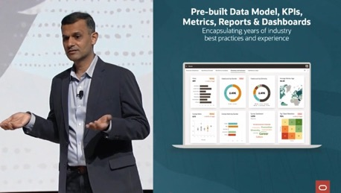

DESIGN

Slide 9

Take a look at this StreamSets VT
PLAY

Slide 10
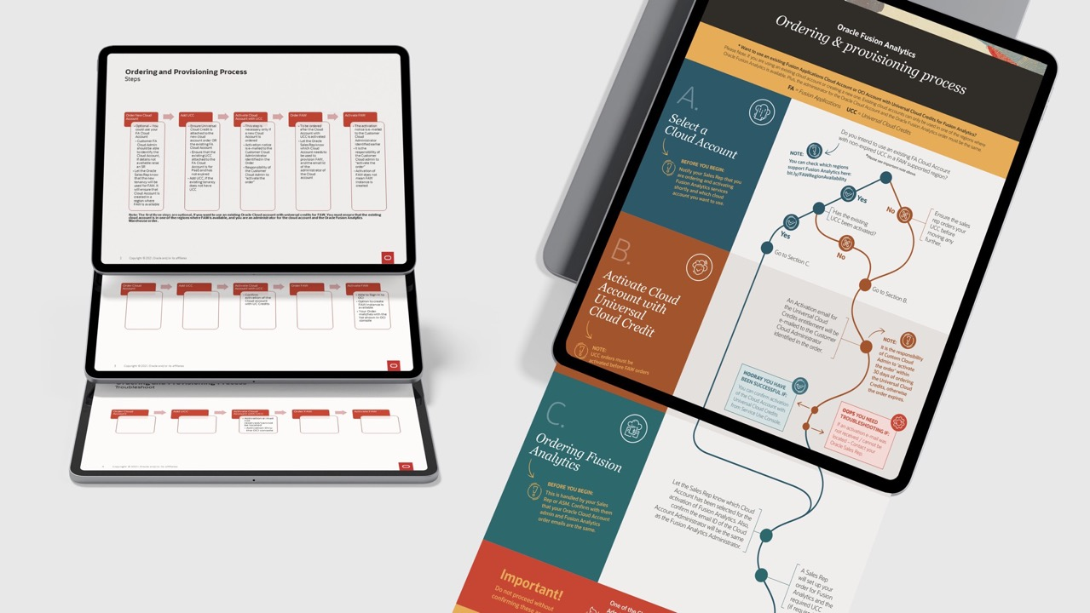

Slide 11


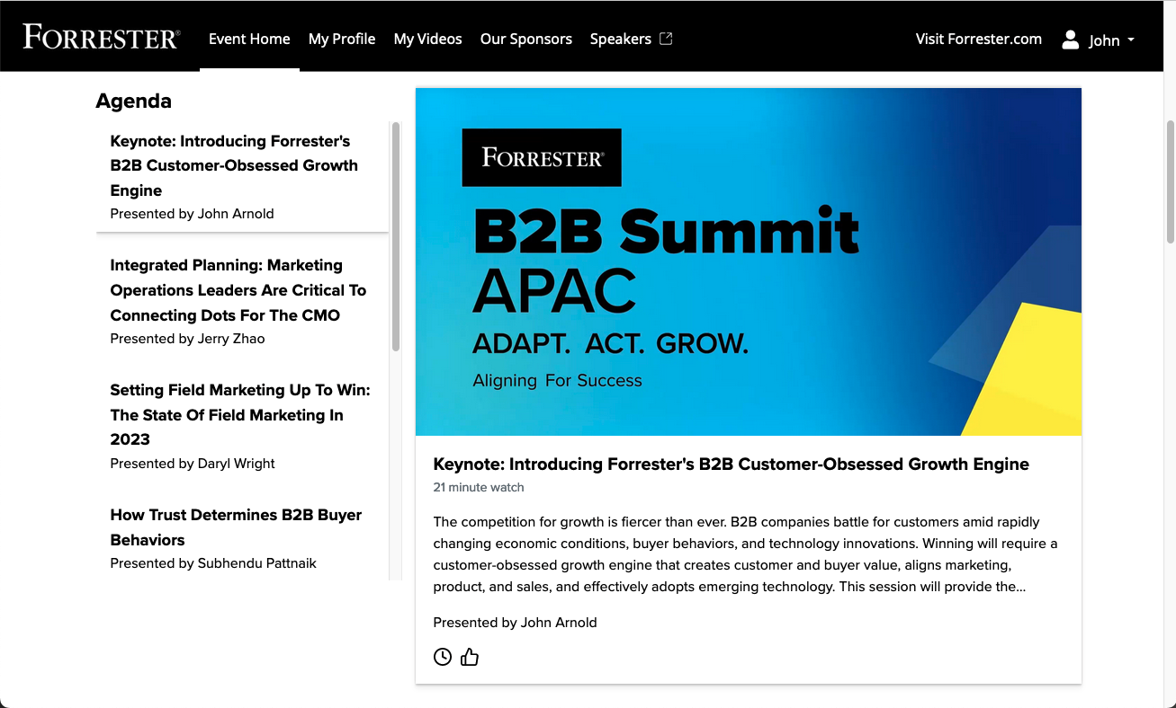
DIGITAL

Slide 12

PRODUCT STORYTELLING
We illuminate innovation through cutting edge video stories that change lives
R&D storytelling
Product launch hero videos
Marketing and advertising content
Content series design and production
Take a look at this Product VT- Pattern VT

Slide 13
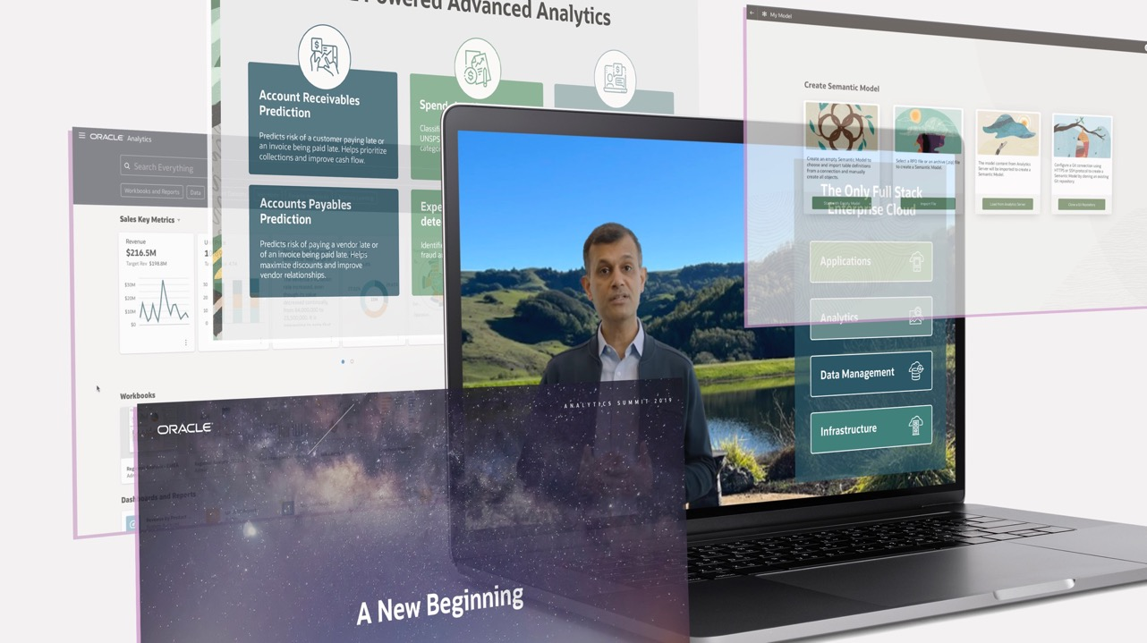
DIGITAL ASSETS
Creating digital assets in animated presentations to uplift and continue Oracle Analytics look and feel cadence.

Slide 14
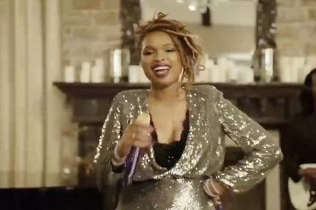
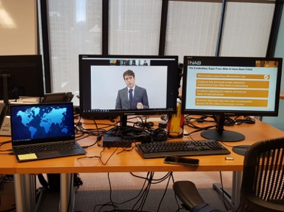
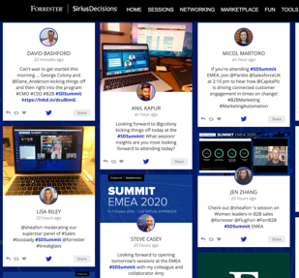
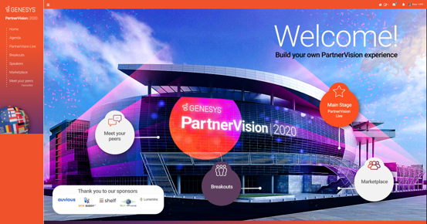
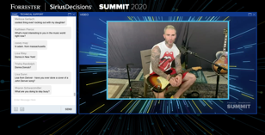
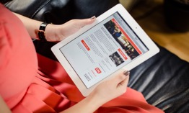
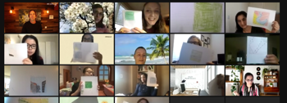


Slide 15

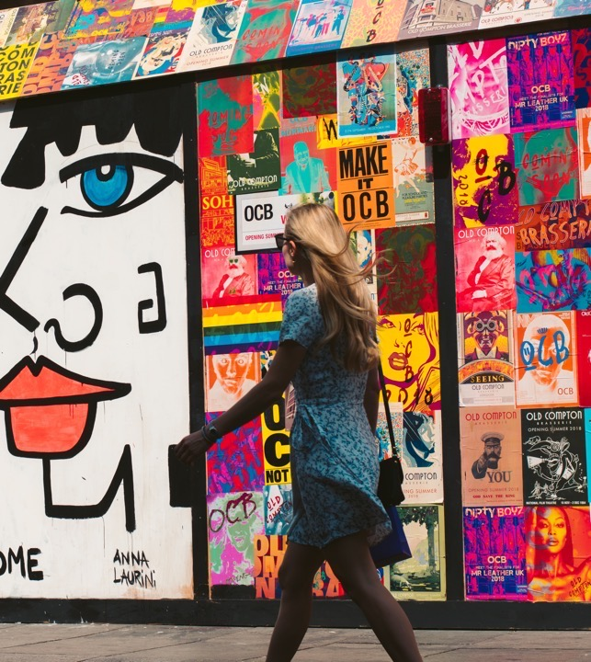

EXPERIENCE
Getting together has new meaning: whether virtually or in-person, we want it to matter.
Relying on tired old formats is a thing of the past: today’s experiences need to offer something more.
As well as creating dazzling visual content that tells a compelling story, Whitewall can bring it to life through holistic and immersive experiences that bring the audience into the heart of your brand.
Whatever the format, whatever the audience,
we’ll create an experience like no other.

Slide 16
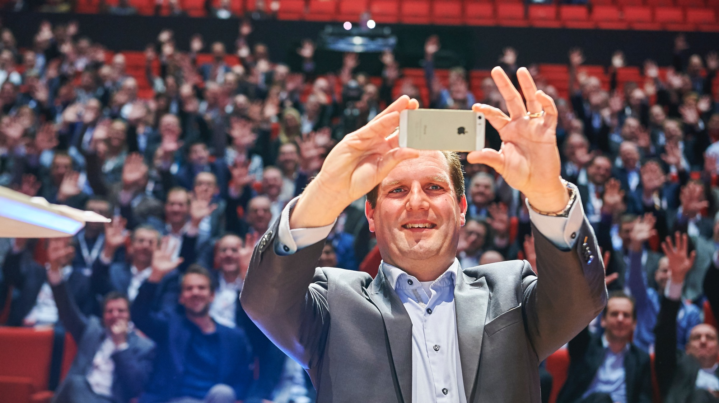

Slide 17
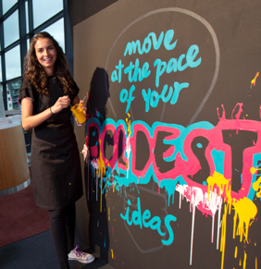
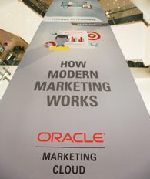

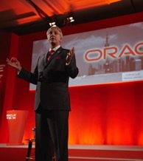
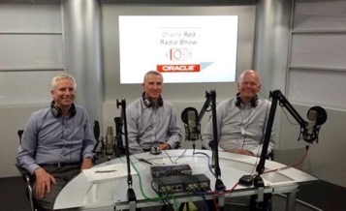

Slide 18
How can we support you?

Slide 19

THANK YOU

