Slide 1
"I finally reached the point where I knew I had to become involved or shut up."
Harvey Milk

Slide 2
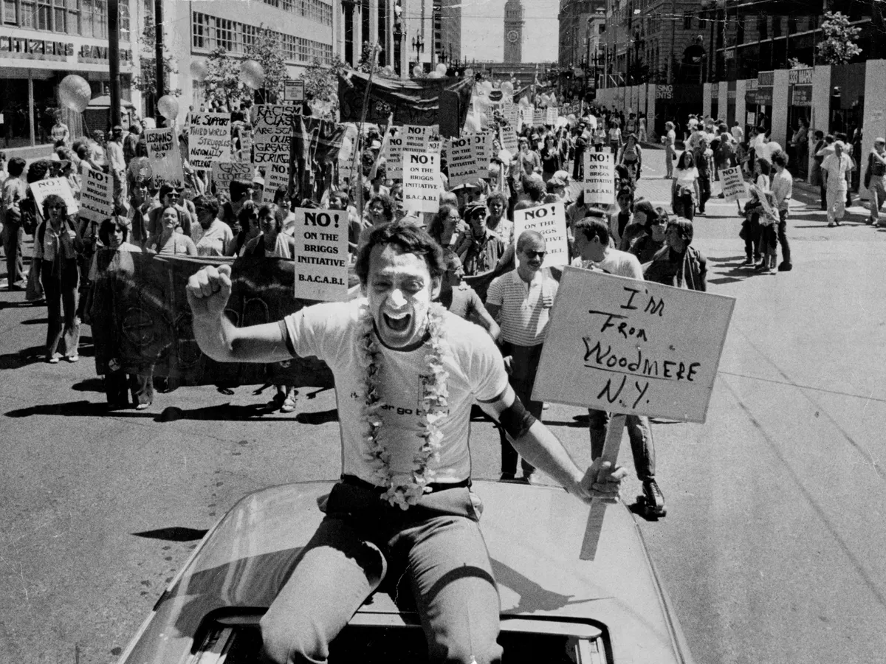

Slide 3
TO ALL THOSE WHO FOUGHT

Slide 4
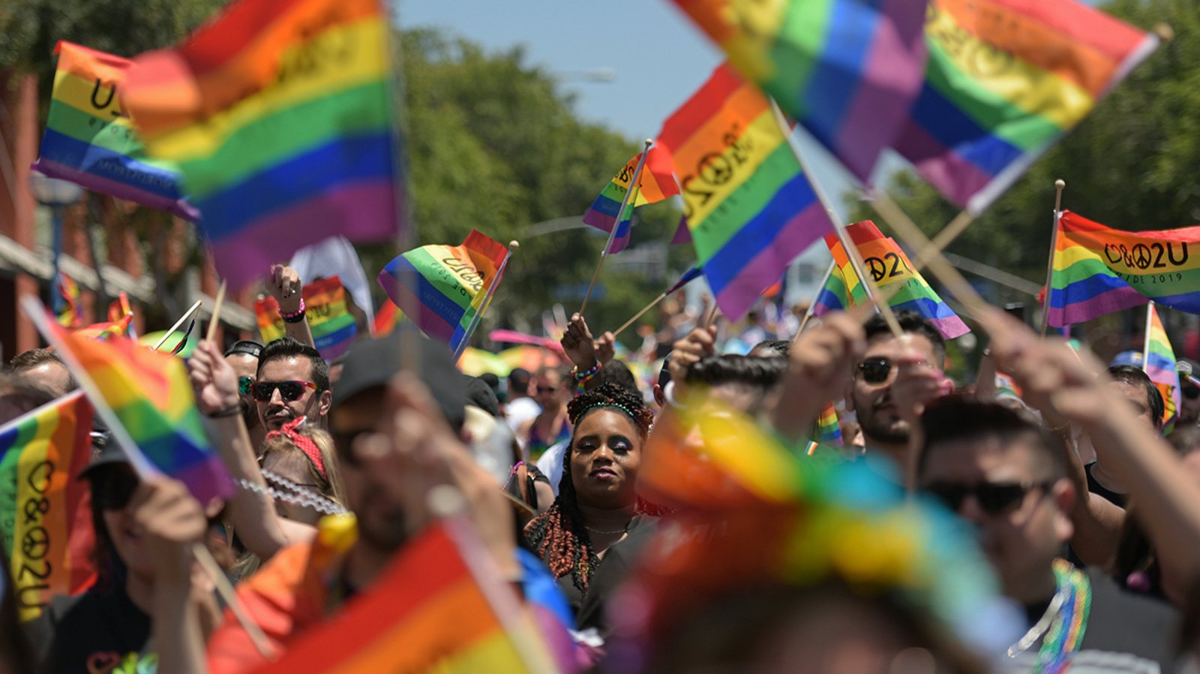

Slide 5
AND THOSE
STILL FIGHTING

Slide 6
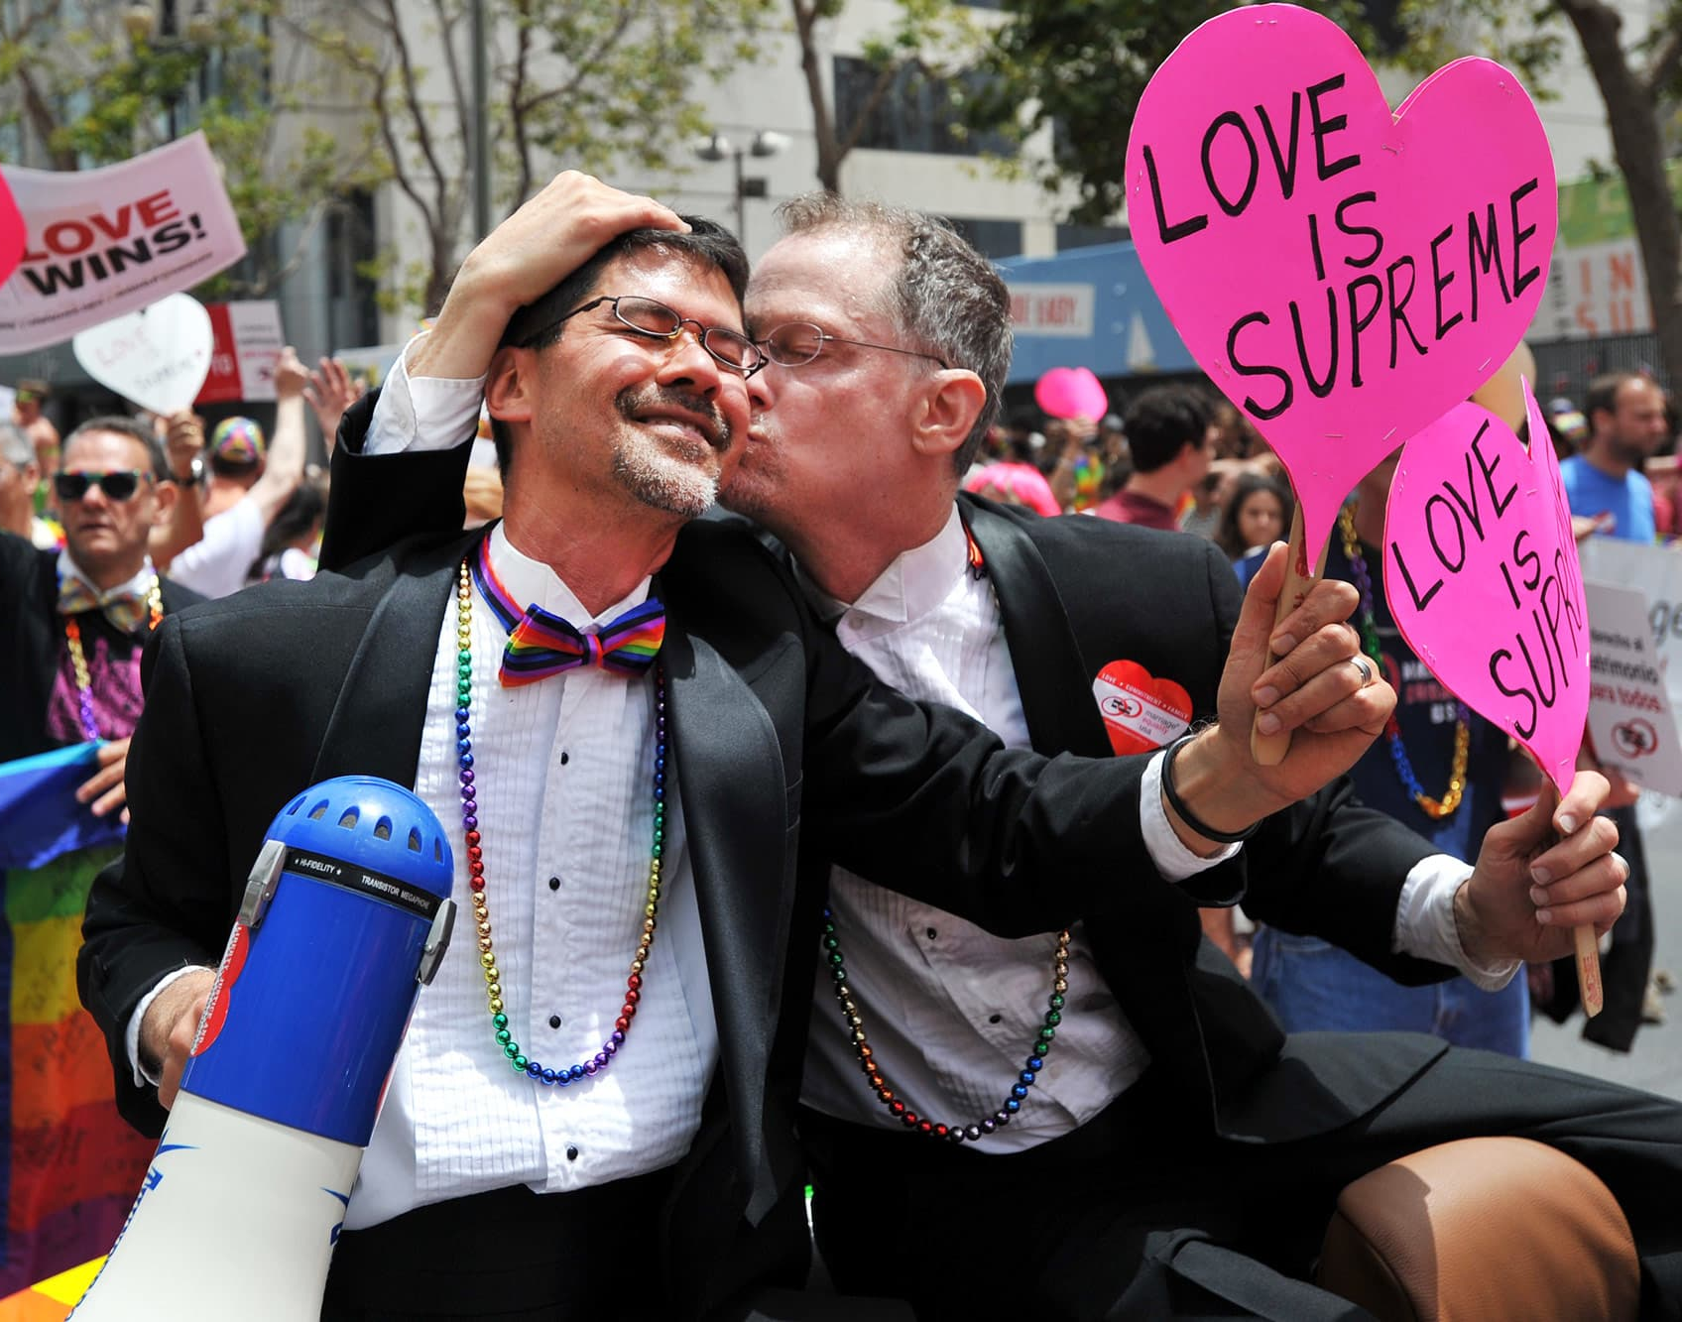

Slide 7
WE STAND
WITH YOU

Slide 9
MAKE EVERY MOMENT
PROUD

